Slide 1
Introduction to Programming

Slide 2
Object-oriented programming (OOP)
Object-oriented programming (OOP) is a programming paradigm based on the concept of "objects“.
Object may contain data, in the form of fields, often known as attributes; and code, in the form of procedures, often known as methods.
For example, a person is an object which has certain properties such as height, gender, age, etc. It also has certain methods such as move, talk, and so on.

Slide 3
Object
This is the basic unit of object-oriented programming.
Objects are like real-life entities. They have their properties and methods.
That is both data and function that operate on data are bundled as a unit called an. Object
Eg:
Consider a car as an object. The car has so many characteristics like colour, company name, modal name and price, etc.
we can perform actions like start, break, and stop these are the methods

Slide 4
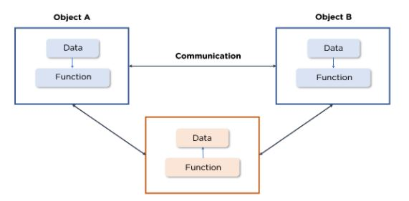

Slide 5
Class
Class is a blueprint of a real-life entity.
It describes how the object will look alike, what characteristics it holds and what kind of actions we can perform on it.

Slide 6
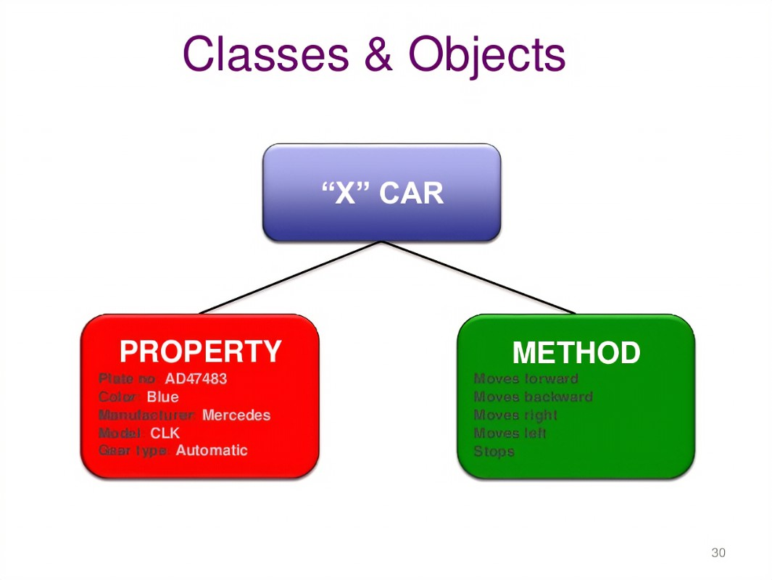
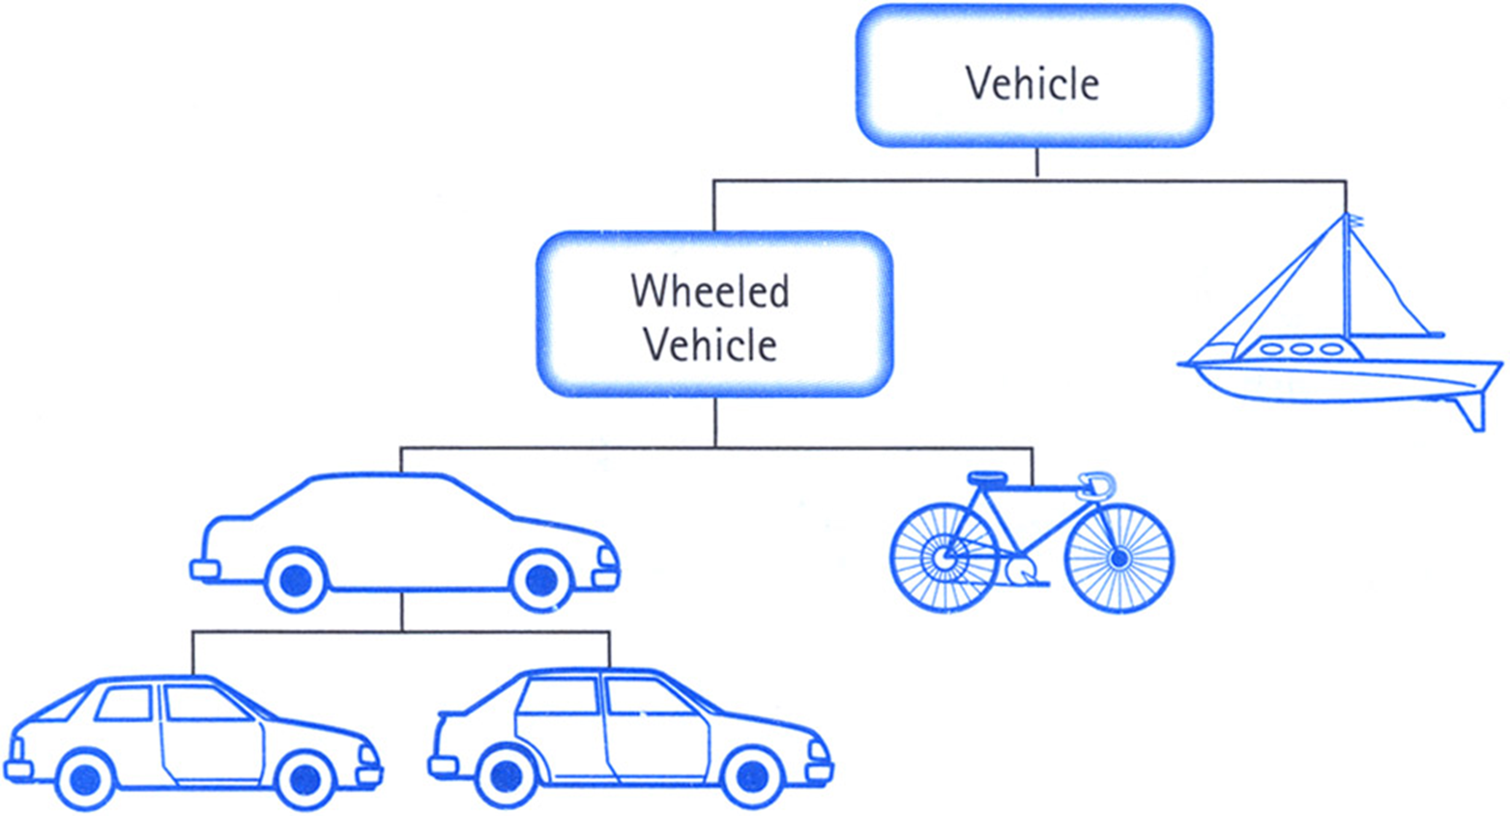
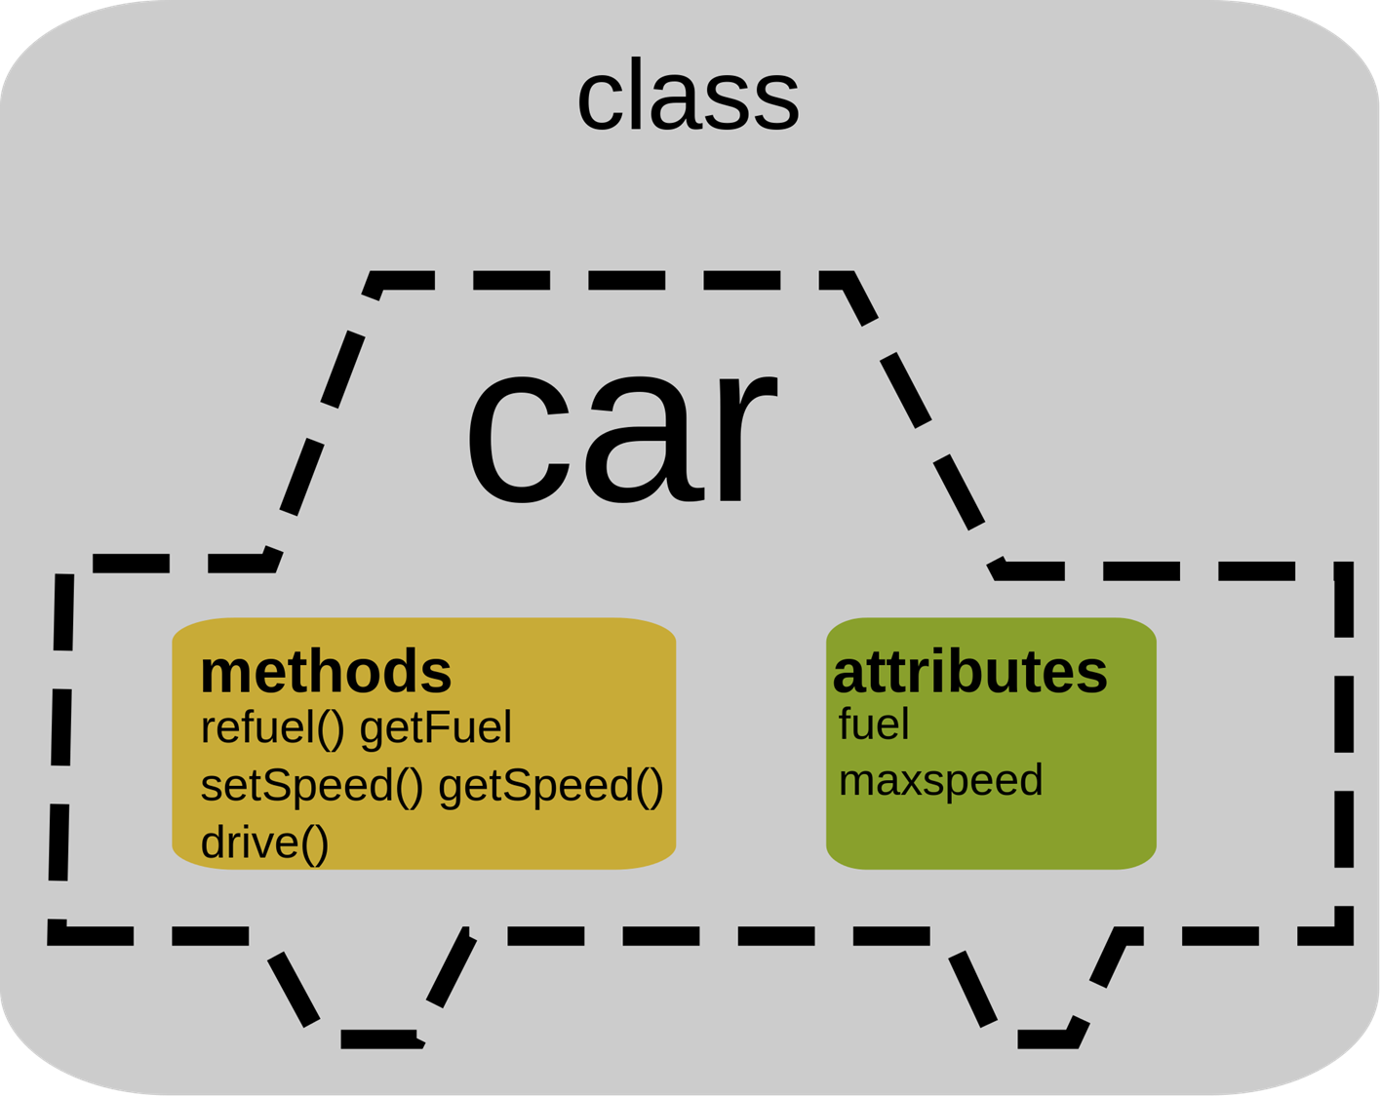

Slide 7
OOP has four basic concepts on which it is totally based.
Abstraction
Encapsulation
Inheritance
Polymorphism

Slide 8
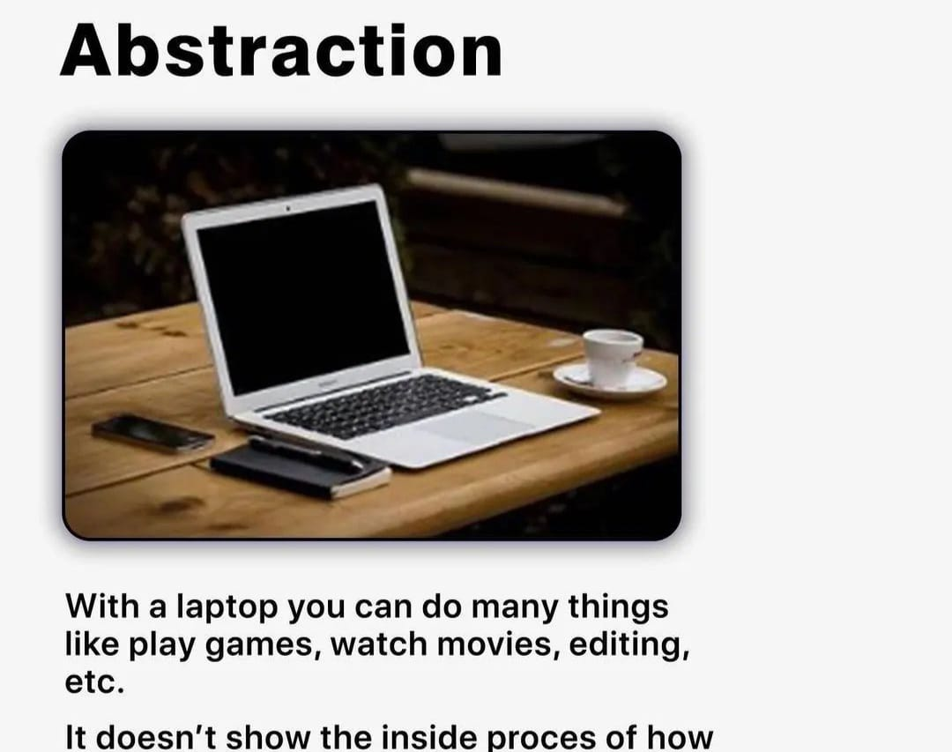
Abstraction
It refers to, providing only essential information to the outside world and hiding their background details.

Slide 9
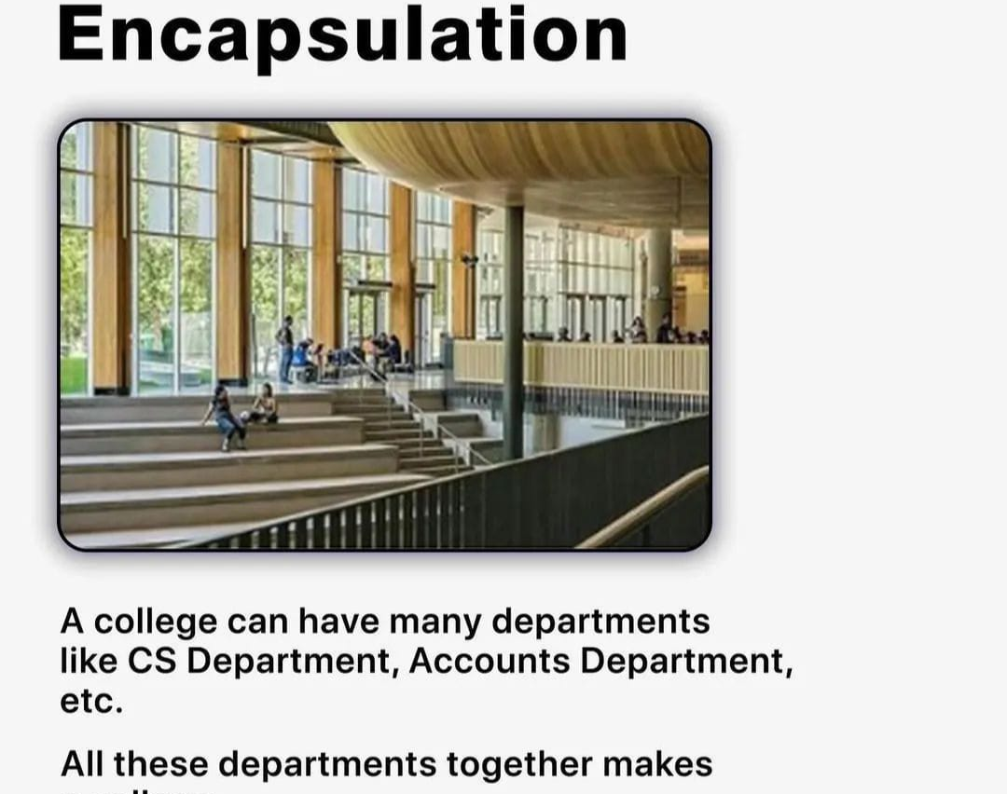
Encapsulation
Encapsulation is a process of binding data members (variables, properties) and member functions (methods) into a single unit.
It is also a way of restricting access to certain properties or component. The best example for encapsulation is a

Slide 10
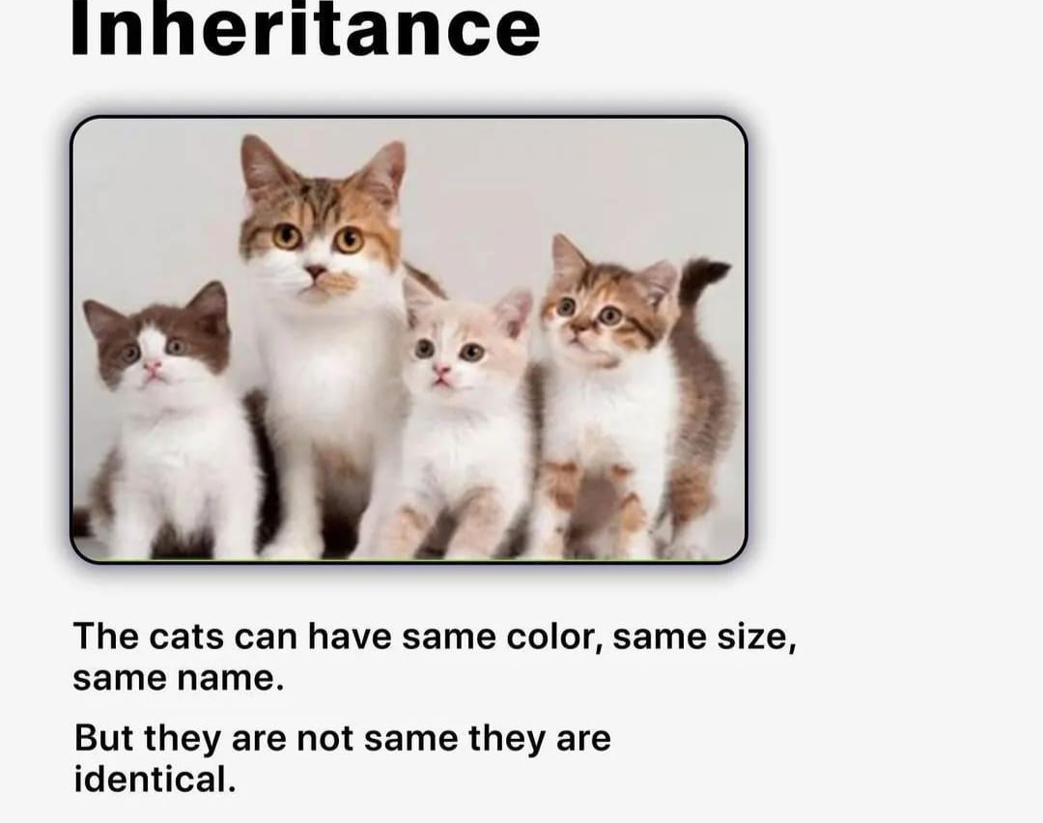
Inheritance
The ability to create a new class from an existing class is called Inheritance.
Using inheritance, we can create a Child class from a Parent class such that it inherits the properties and methods of the parent class and can have its own additional properties and methods.

Slide 11
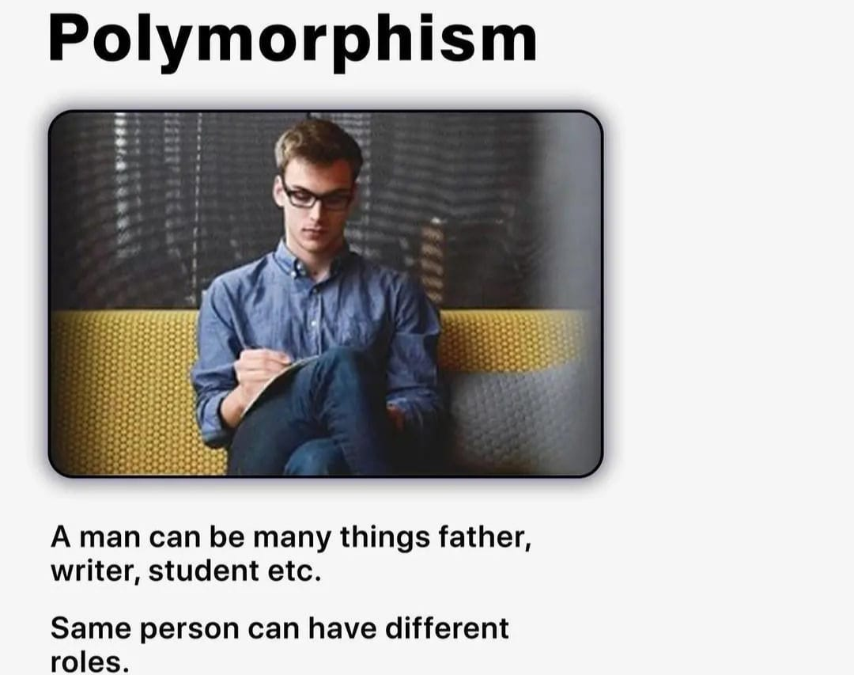
Polymorphism
The word polymorphism means having many forms.
Polymorphism occurs when there is a hierarchy of classes and they are related by inheritance.

Slide 12
Data structure
Data structure is a particular way of storing and organizing data in a computer so that it can be used efficiently.
eg: Array, stack, tree, heap, hash table.

Slide 13
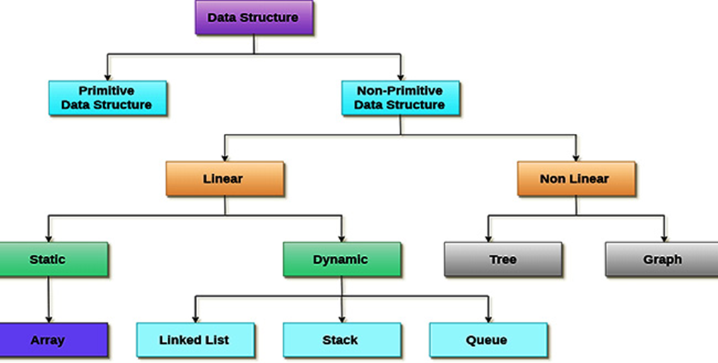
Data structure

Slide 14
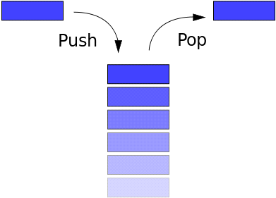
Stack
A stack is a particular data type or collection in which the main operations are the addition of an item, known as push, and removal of it, known as pop.
Stacks implement a LIFO (Last In First Out) structure which means that the last element added to the structure must be the first one to be removed.
Memory Management: In JavaScript, the stack is used for storing simple data types like numbers, booleans, and references to objects (primitive data types). Function calls, along with their local variables, are also stored in the stack. When a function is called, a new stack frame is created, and when the function completes, the stack frame is popped off the stack.

Slide 15
Heap
The heap is an unstructured memory pool where data can be stored and accessed in a more flexible manner.
Memory Management: In JavaScript, the heap is used to allocate memory for objects, arrays, and functions—essentially anything that requires more memory than what's available on the stack.
The heap allows for dynamic memory allocation, meaning that the size of these structures can grow as needed.

Slide 16
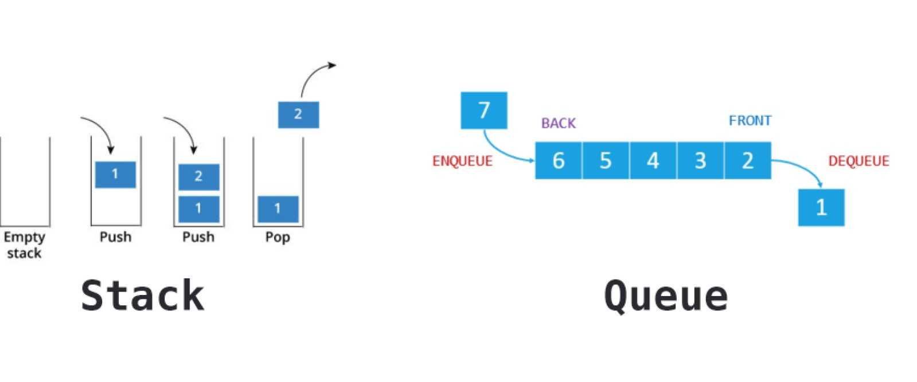
Queue
Queues are collection that keep objects in a certain order while applying the FIFO (First in First out) format. It is just like a line of people, except that data doesn't cut in it.
Adds an item at the front of the queue. The process is the same as PUSH from stack, but I changed for the sake of the exercise.

Slide 17
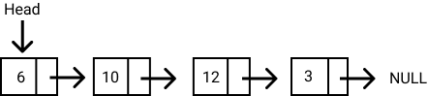
Linked list
Linked lists are data structures that are made of groups of nodes which together represent a sequence.
A linked list is a linear data structure where each element (called a node) contains a value and a reference (or link) to the next node in the sequence.
JavaScript doesn’t have a built-in linked list, but it can be implemented manually.

Slide 18
Algorithms
Writing a logical step-by-step method to solve the problem is called the algorithm.
In other words, an algorithm is a procedure for solving problems.
In order to solve a mathematical or computer problem, this is the first step in the process.
An algorithm includes calculations, reasoning, and data processing. Algorithms can be presented by natural languages, pseudocode, and flowcharts, etc.

Slide 19
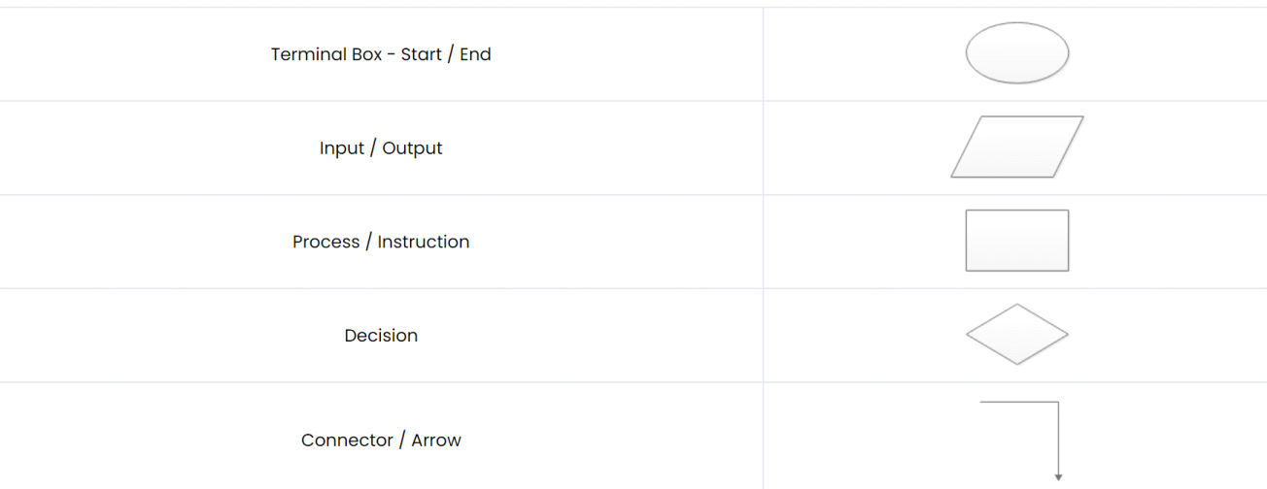
Flowchart
Flowcharting is the process of drawing a flowchart for an algorithm. The flowchart uses various symbols in the representation.

Slide 20
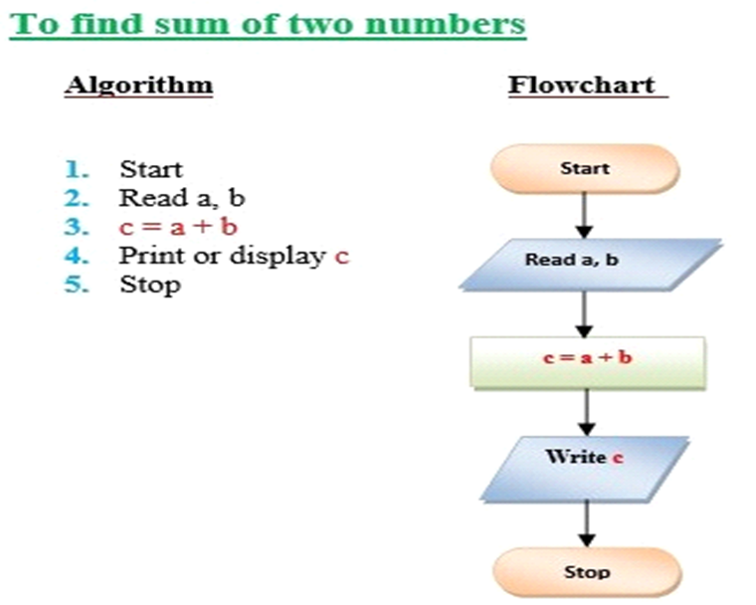

Slide 21
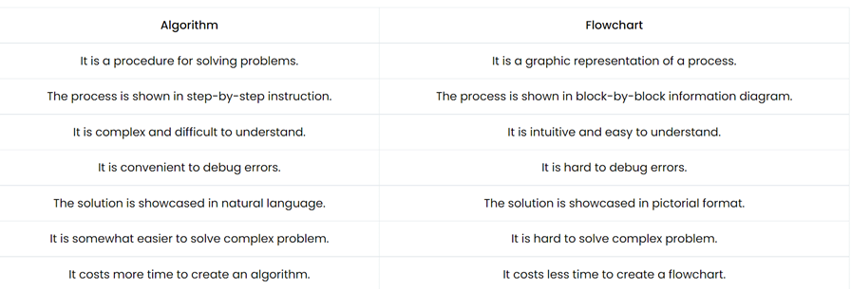

Slide 22
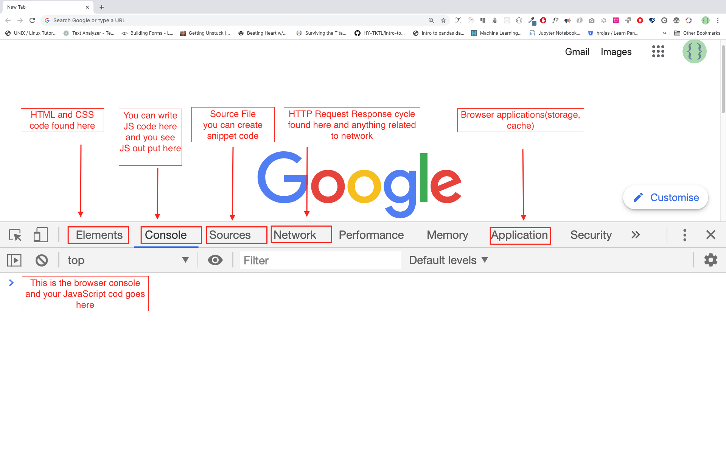

Slide 23
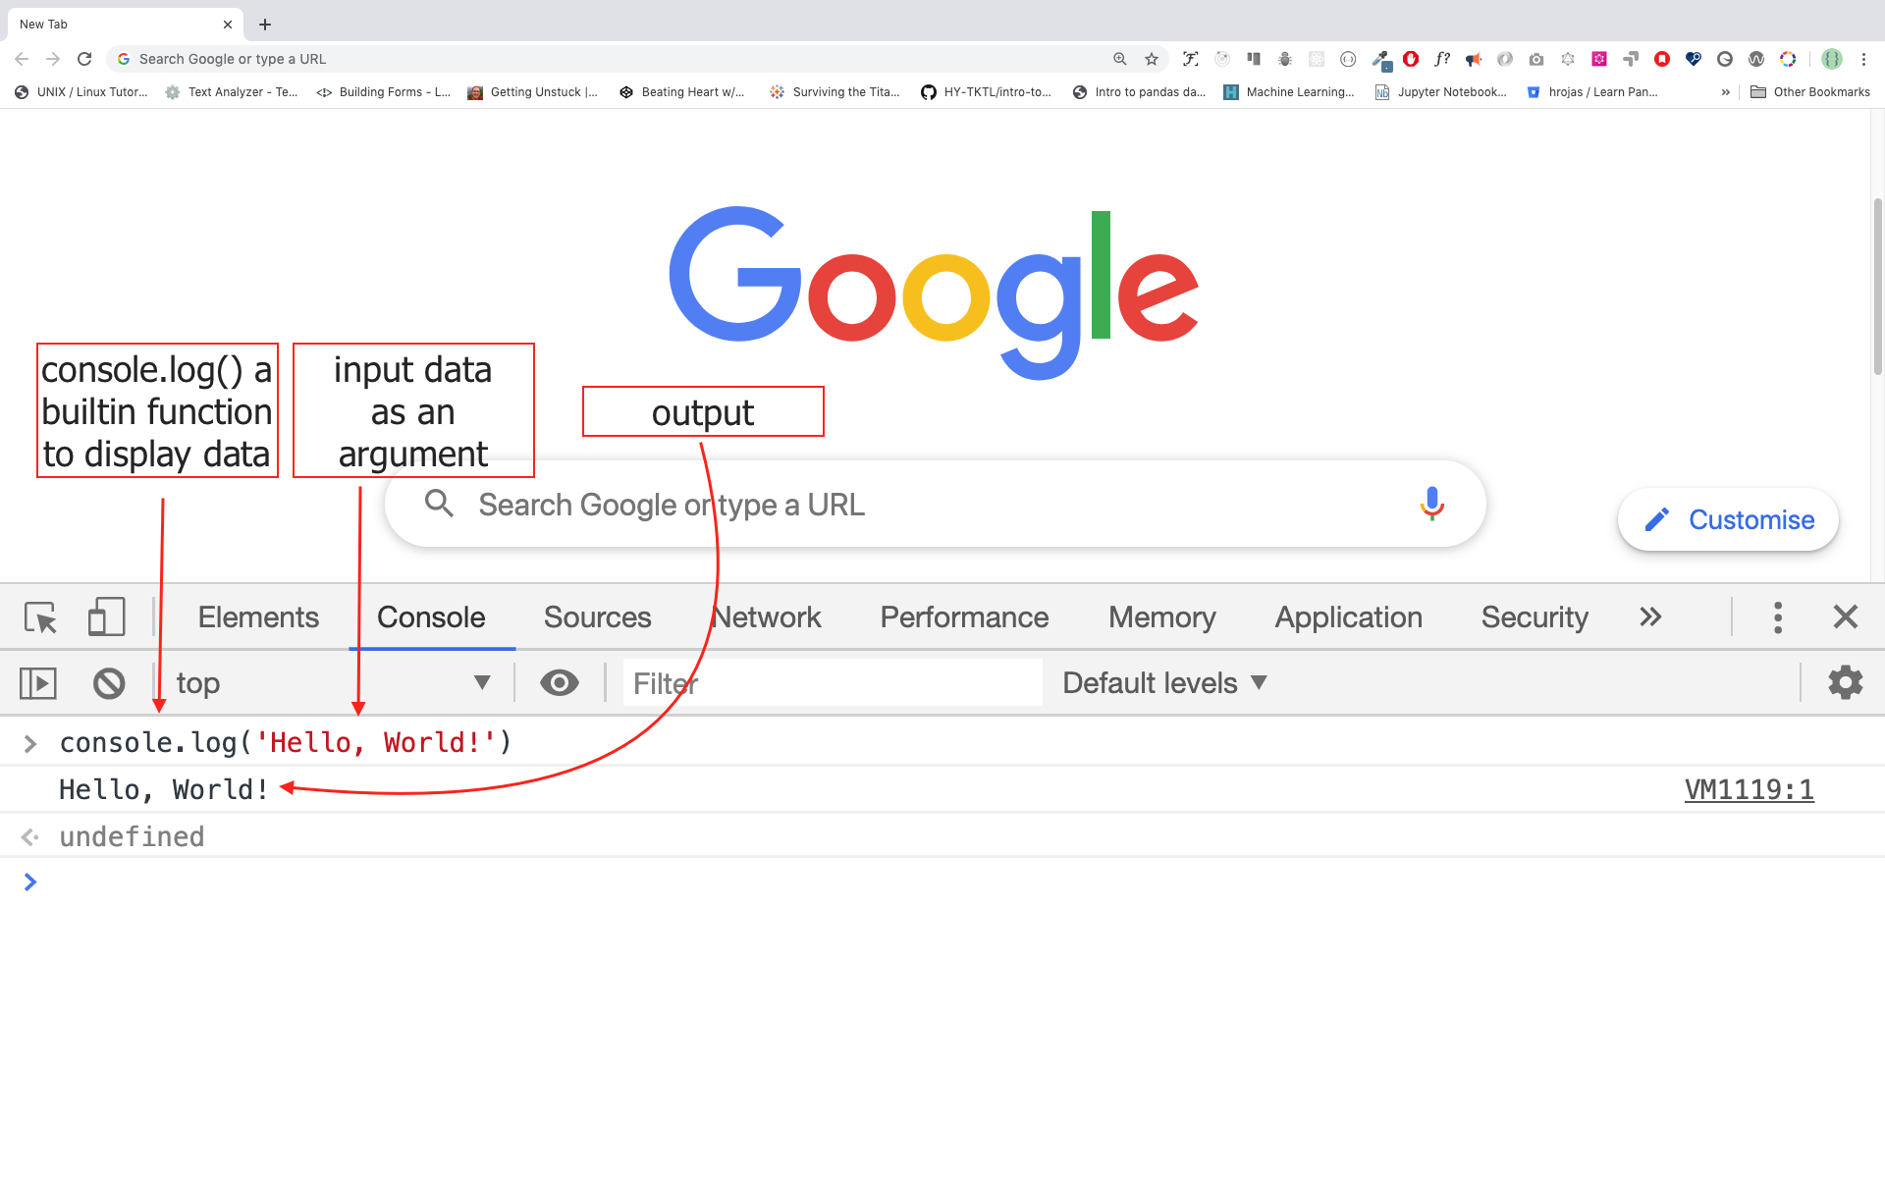

Slide 24
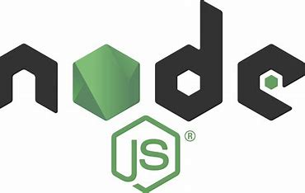
NodeJs
What is Node.js?
Node.js is an open source server environment
Node.js runs on various platforms (Windows, Linux, Unix, Mac OS X, etc.)
Node.js uses JavaScript on the server
Node.js can generate dynamic page content
Node.js can create, open, read, write, delete, and close files on the server
Node.js can collect form data
Node.js can add, delete, modify data in your database

Slide 25
Download Node.js
Official Node.js website has installation instructions for Node.js: https://nodejs.org

Slide 26
JavaScript
JavaScript is a programming language used to make websites interactive on the frontend and to handle data and server tasks on the backend.
JavaScript has no compilation step. Instead, an interpreter in the browser reads over the JavaScript code, interprets each line, and runs it.
More modern browsers use a technology known as Just-In-Time (JIT) compilation, which compiles JavaScript to executable bytecode just as it is about to run.
Runs in the browser (via the JavaScript engine) or on the server (e.g., using Node.js).

Slide 27
JavaScript
JavaScript is a versatile programming language used for both frontend and backend development.
Frontend (Client-side): JavaScript is used to create interactive and dynamic elements on web pages, such as dropdown menus, form validations, and content updates without reloading the page. It runs directly in the user's browser.
Backend (Server-side): JavaScript, with the help of environments like Node.js, can also be used on the server to handle database operations, manage server logic, and process requests from the client, making it a full-stack language.

Slide 28
History of JavaScript
1995:
Developed by Brendan Eich at Netscape.
Originally named Mocha, later renamed to LiveScript, and finally JavaScript.
Introduced as a scripting language for Netscape Navigator.
1996:
Microsoft created a JavaScript variant called JScript for Internet Explorer.
The competition between Netscape and Microsoft led to JavaScript becoming more standardized.
1997:
JavaScript was standardized as ECMAScript 1 (ES1) by ECMA International.
This created a common standard for all browsers.
1999:
ECMAScript 3 (ES3) was released, bringing regular expressions, try-catch error handling, and better string manipulation.
2009:
ECMAScript 5 (ES5) introduced strict mode, JSON support, and array methods like map(), filter(), and reduce().

Slide 29
JavaScript Versions
2015:
ECMAScript 6 (ES6) marked a significant leap forward with features like:
let and const for block scoping.
Arrow functions.
Classes and modules.
Promises for asynchronous programming.
2016 to Present:
Annual ECMAScript updates introduce incremental improvements.
Examples of modern features:
Async/await (2017).
Optional chaining (2020).
New methods like Object.groupBy and Promise.withResolvers (2024).
Current Status:
JavaScript is one of the most widely used programming languages in the world.
It powers modern web development frameworks like React, Angular, and Vue, and is essential for building scalable, interactive applications.

Slide 30
ECMAScript 1 (First Version):
Released in June 1997.
Established the foundation for JavaScript as a standard scripting language.
Introduced basic features like variables, functions, and control structures.
ES6 (ECMAScript 6):
Released in 2015.
Introduced many powerful new features, such as:
Arrow functions.
Destructuring.
Classes.
Promises.
Modules.
Current Version (ECMAScript 2024): (ES15)
Published in June 2024.
Key new features include:
Object.groupBy and Map.groupBy methods.
Promise.withResolvers for easier promise management.
Set operations added to Set.prototype.
/v Unicode flag for regular expressions.

Slide 31
1.JavaScript Programs
A computer program is a list of "instructions" to be "executed" by a computer.
In a programming language, these programming instructions are called statements.
A JavaScript program is a list of programming statements.

Slide 32
2. JavaScript Statements
JavaScript statements are composed of: Values, Operators, Expressions, Keywords, and Comments.
Most JavaScript programs contain many JavaScript statements.
The statements are executed, one by one, in the same order as they are written.

Slide 33
3. Semicolons ;
Semicolons separate JavaScript statements.
Add a semicolon at the end of each executable statement:
End of Statements: Generally, you use a semicolon to terminate a statement.
let x = 5;
let y = 10;
console.log(x + y);
Multiple Statements on One Line: let a = 1; let b = 2; let c = a + b;

Slide 34
4. Keywords
JavaScript statements often start with a keyword to identify the JavaScript action to be performed.
JavaScript keywords are reserved words. Reserved words cannot be used as names for variables
const Declares a block constant
function Declares a function
switch Marks a block of statements to be executed in different cases
for Marks a block of statements to be executed in a loop

Slide 35
5. Variables
Variables are containers that store values.
JavaScript uses the keywords var, let and const to declare variables.
Variables allow computers to store and manipulate data in a dynamic fashion. They do this by using a "label" to point to the data rather than using the data itself.
By declaring a variable with the let keyword, followed by the name you give to the variable:
let myVariable;

Slide 36
Declaring a variable
// declaring single variable
var name;
// declaring multiple variables
var name, title, num;
// initializing variables
var name = "Harsh";
name = "Rakesh";

Slide 37
Initializing a variable
An equal sign is used to assign values to variables.
After declaring a variable, you can give it a value:
myVariable = 20;
Also, you can do both these operations on the same line:
let myVariable = 20;

Slide 38
4 Ways to Declare a JavaScript Variable:
Using nothing
var: Introduced in ES1, function-scoped or globally scoped.
let: Introduced in ES6, block-scoped and allows reassignment.
const: Introduced in ES6, block-scoped and cannot be reassigned.

Slide 39
Variable Hoisting in JavaScript
What is Hoisting? Hoisting is a JavaScript mechanism where variable and function declarations are moved to the top of their scope during the compilation phase, before the code is executed.
Declarations are hoisted, but initializations are not.This means you can use a variable before it is declared, but it will have the value undefined (in the case of var).
console.log(a); // Output: undefined
var a = 10;

Slide 40
6. Identifiers
JavaScript identifiers are the name that we give to variables, objects, functions, arrays, classes, etc. We must use a unique name so as to identify them.
We then use the identifier to refer to the variable, functions, etc elsewhere in the program.
There are certain rules & restrictions that we must follow when we name an identifier.
Eg: var message =”hello world”;

Slide 41
JavaScript Identifiers Rules
The identifier name must be unique within the scope.
The first letter of an identifier should be a upper case letter, Lower case letter, underscore, dollar sign.
The subsequent letters of an identifier can have upper case letter, Lower case letter, underscore, dollar sign, numeric digit
We cannot use reserved keywords. You can find the list of keywords for here.
They are case-sensitive. For Example, sayHello is different from SayHello
Cannot use spaces in a identifier name.
Avoid using the JavaScript Reserved Keywords as identifier name

Slide 42
JavaScript console.log() Method
The console.log() is a function in JavaScript that is used to print any kind of variables defined before in it or to just print any message that needs to be displayed to the user.
Syntax:
console.log(“Code with Me");
var a = 2;
console.log(a);
var str = “LUMINAR TECHNOLAB";
console.log(str);

Slide 43
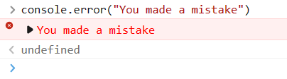
JavaScript console.error() Method
Outputs an error message to the console

Slide 44
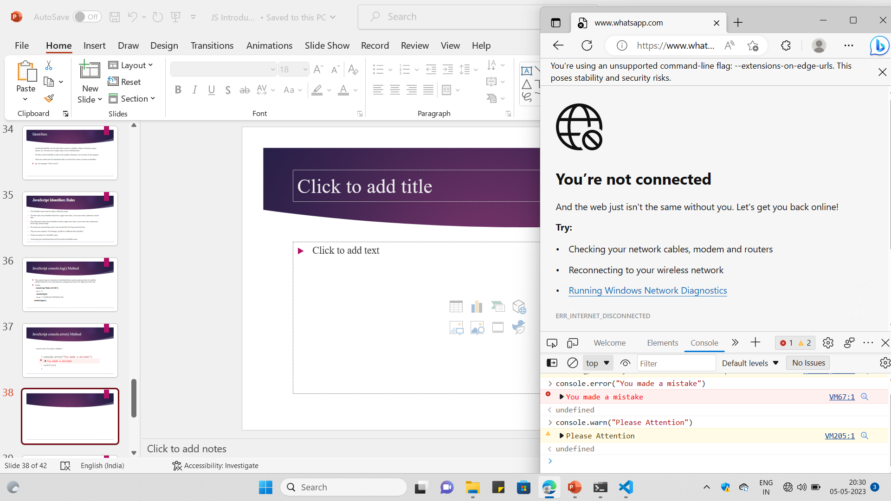
JavaScript console.warn() Method
Outputs a warning message to the console

Slide 45
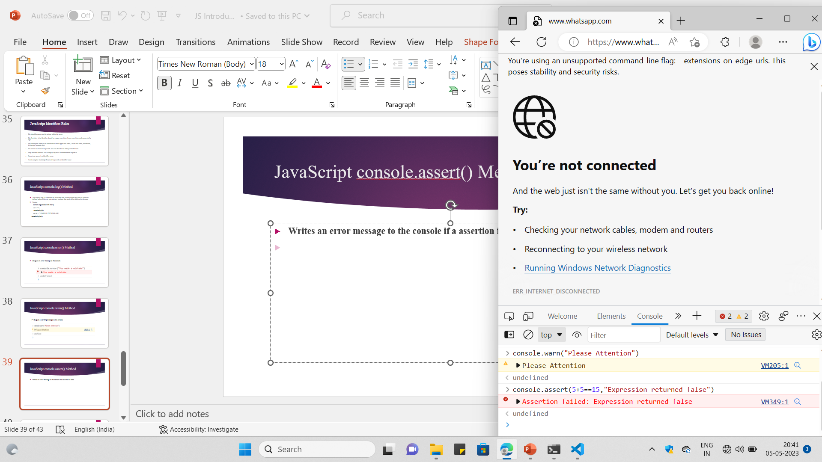
JavaScript console.assert() Method
Writes an error message to the console if a assertion is false

Slide 46
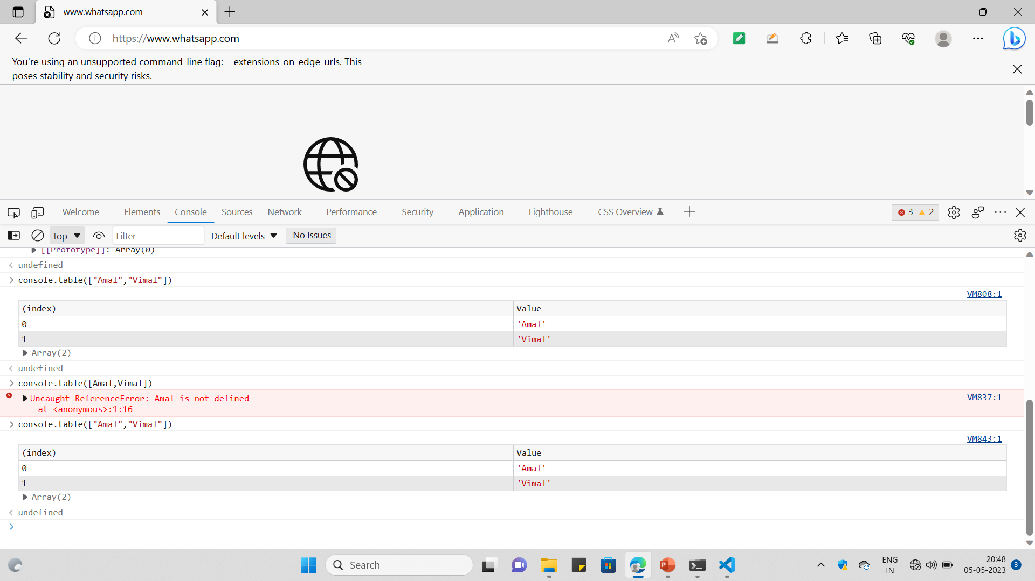
JavaScript console.table() Method

Slide 47
JavaScript console.clear() Method
Clear the console

Slide 48
Comments
Not all JavaScript statements are "executed".
Code after double slashes // or between /* and */ is treated as a comment.
Comments are ignored, and will not be executed

Slide 49
JavaScript and Camel Case
Historically, programmers have used different ways of joining multiple words into one variable name:
Hyphens:
first-name, last-name, master-card, inter-city.
Hyphens are not allowed in JavaScript. They are reserved for subtractions.

Slide 50
Underscore: snakecase- get_input
first_name, last_name, master_card, inter_city.
Upper Camel Case (Pascal Case):
FirstName, LastName, MasterCard, InterCity.
Lower Camel Case:
JavaScript programmers tend to use camel case that starts with a lowercase letter:
firstName, lastName, masterCard, interCity.

Slide 51
TASKS
What are the features of javascript?
What are the main Advantages of js?
What JS is used for?
Difference between var, let, const?
What are most popular JS Libraries

